Slide 1
Welcome
Student Information System
A simple management system to store all
necessary information of students
Team Members :
1. Tasfia Anika Bushra (12-01-04-056)
2. Jubayer Sanim (12-01-04-076)
3. Dewan Ziaul Karim (12-01-04-077)

Slide 2
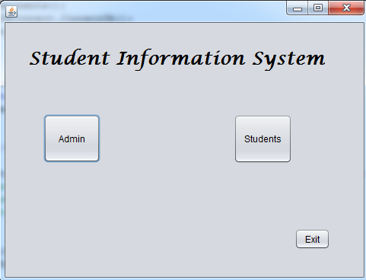
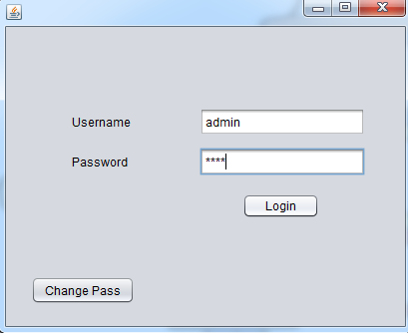
First View of our software
Two Sections – Admin & Students
Admin Panel –
Login using necessary information…

Slide 3
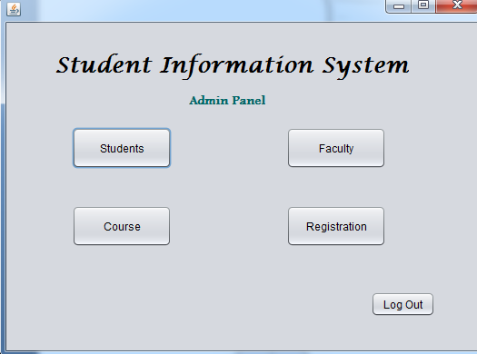
Successful Login >> 4 sections –
1.Students 2.Faculty 3.Course 4.Registration
Logout option available
Let’s see an example of one of these section--
Students

Slide 4
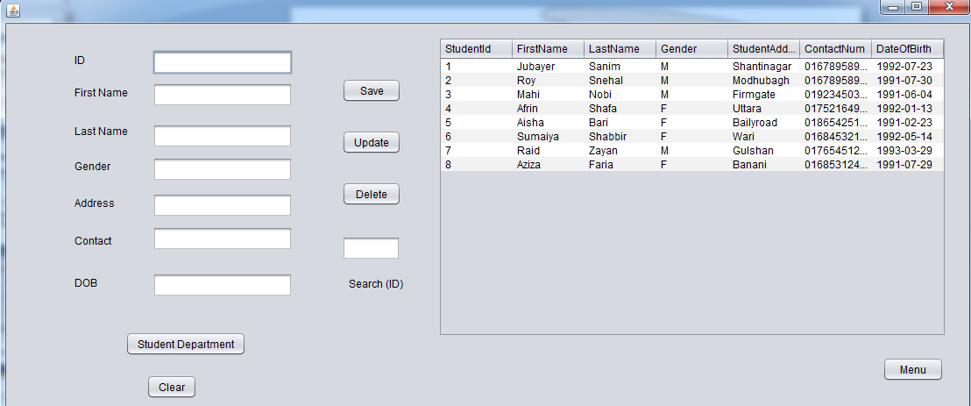
Data from SQL Server Database
Text fields for inserting new data
Options for Insert , Update , Delete, Search (using ID)
Other sections are almost as same as this one

Slide 5
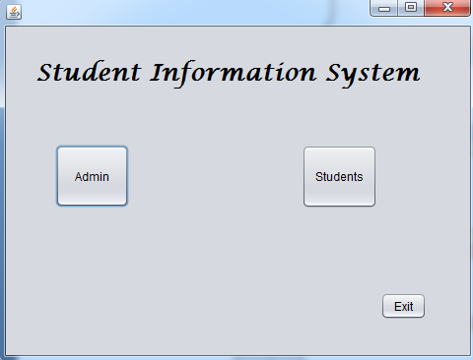
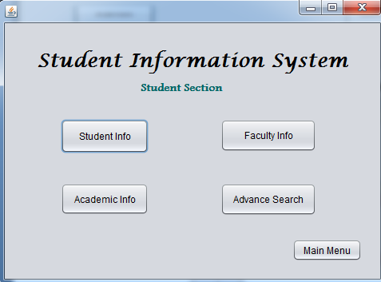
Now let’s see the Students Section of our software
After entering, first view of the Students Section

Slide 6
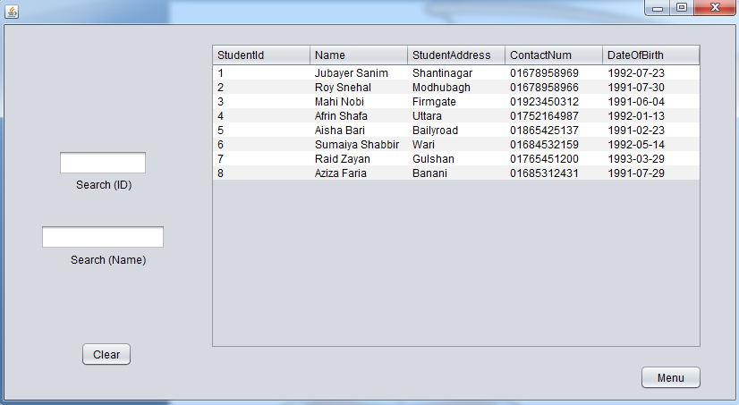
Retrieved data from the SQL server database
Option to search with ID & Name
Searching is Efficient , let’s see an example

Slide 7
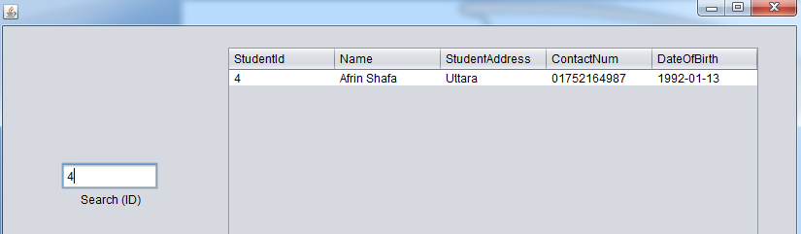
User writes an ID in the search field , result automatically shows up in the table

Slide 8

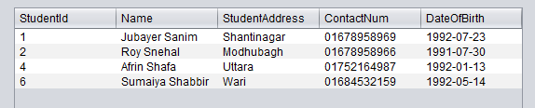


User writes ‘s’ , all names which have ‘s/S’ in the First Name or Last Name
starts to show up
User writes more keywords as in ‘sn’ , he/she gets more accurate result
So as we see, it is a complete keyword based live search

Slide 9
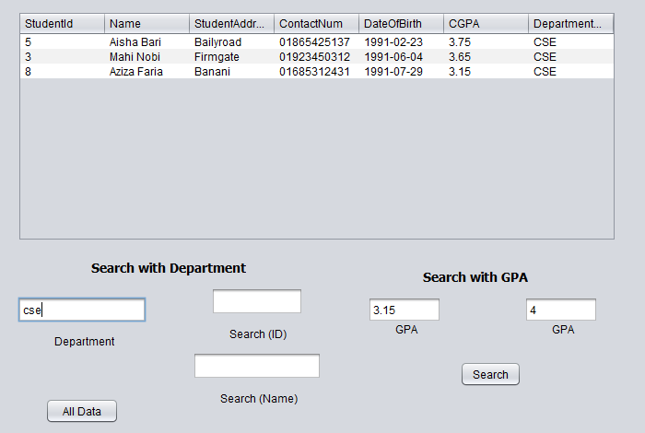
More Advanced Search using Department Name , GPA etc.
This is all from our project …

Slide 10

Any Questions ??

